Slide 1
Module 2: Mathematical Foundations of AI and Data science
Role of linear algebra in Data representation and analysis
Matrix decomposition
Singular Value Decomposition (SVD)
Spectral decomposition
Dimensionality reduction technique
Principal Component Analysis (PCA)

Slide 2
Role of linear algebra in Data representation and analysis
The mathematical foundations needed for Artificial Intelligence and Machine Learning (AI/ML)
Linear algebra
Calculus
Probability and statistics
Optimization
Linear algebra provides the tools to represent and manipulate data using vectors and matrices, which form the backbone of data processing in machine learning algorithms.

Slide 3
Role of linear algebra in Data representation and analysis
Calculus, particularly differential calculus, is essential for understanding how models learn, especially during gradient-based optimization used in training neural networks.
Probability and statistics help in modeling uncertainty, making predictions, and analyzing patterns within data.
Optimization techniques are critical for improving model performance by minimizing errors or loss functions.

Slide 4
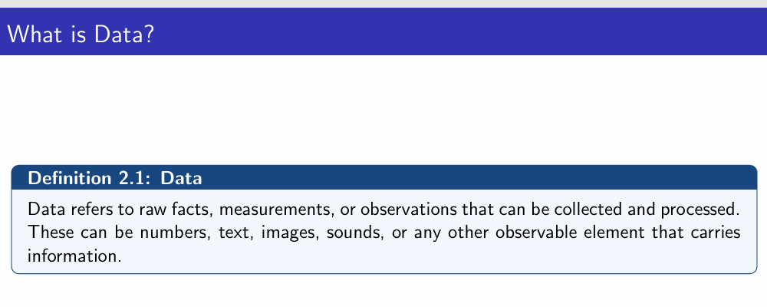

Slide 5
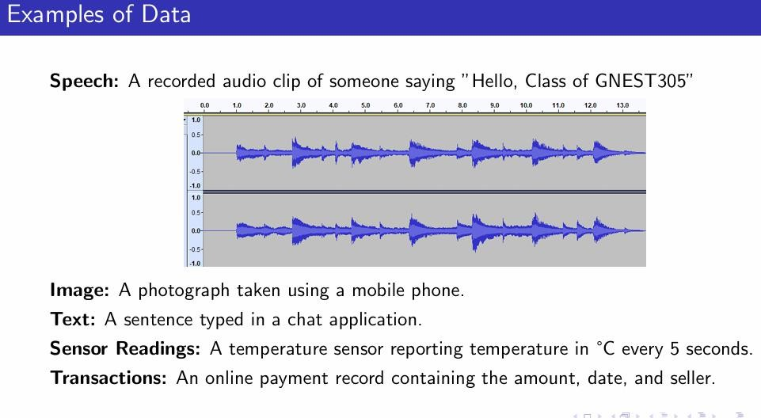

Slide 6
Understanding data
Datasets that store the units of observation and their properties can be imagined as collections of data consisting of the following:
Examples
An “example” is an instance of the unit of observation for which properties have been recorded.
An “example” is also referred to as an “instance”, or “case” or “record.” (It may be noted that the word “example” has been used here in a technical sense.)
Features
◦ A “feature” is a recorded property or a characteristic of examples. It is also referred to as “attribute”, or “variable” or “feature.”

Slide 7
Examples for “examples” and “features”
Cancer detection
Consider the problem of developing an algorithm for detecting cancer. In this study we note the following.
The units of observation are the patients.
The examples are members of a sample of cancer patients.
The following attributes of the patients may be chosen as the features:
Gender
Age
Blood pressure

Slide 8
Table 1: Example for “examples” and “features” collected in a matrix format (data relates to automobiles and their features)

Slide 9
Types of Data
Numerical Data (Quantitative)
Discrete Data
Continuous Data
Categorical Data (Qualitative)
Nominal Data
Ordinal Data
Text Data (e.g., documents, reviews)
Multimodal Data (e.g., image -F text) +

Slide 10
Types of Data
Numerical Data consists of real or integer values that represent measurable quantities.
Discrete data consists of distinct, separate values. It arises from counting things and does not include fractional or decimal parts.
Number of students in a class (e.g., 60, 65 — not 60 4)
Number of books on a shelf (e g. , 10, 11, 12)
Number of goals scored in a match (e g , 2, 3)
Continuous data can assume an infinite number of values within a given interval. It can include whole numbers, decimals, and fractions, and typically results from measurements.
Temperature (e.g., 36.6⁰C, 29.5⁰C)
Speed (e.g., 45.7 km/h, 60.3 km/h)
Height (e g., 160.4 cm, 172.8 cm)

Slide 12
Types of Data
Categorical data consists of labels or names used to identify categories or classifications.
Nominal Data: Categories without any natural order. These are just labels for groups.
Examples: "apple" "banana", "grape", "male" , "female"
There is no ranking: apple is not greater than banana.
Ordinal Data: Categories with a meaningful order or ranking, but no fixed interval.
Examples: "Excellent" , "Good" , "Poor" (Amazon product ratings)
The order is meaningful, but gaps between levels are not uniform.

Slide 13
Identify whether the following data is categorical or numerical value
1. Temperature
2. Yes or No
3. True or False
4. Price
5. Fit or unfit
6. Apple or Orange
7. Humidity

Slide 14
Converting Categorical Data into Vectors
Machine learning models require numerical input. Categorical data must be converted into vectors using encoding techniques:
Label Encoding: Assigns each category a unique number.
Example: "apple" ➔ O, "banana" ➔ 1, "grape" ➔ 2
May imply order that doesn't exist (bad for nominal data)
One-Hot Encoding: Creates a binary vector for each category.
Example: "banana" ➔Y [O, 1, O]
Avoids any assumption of order.
Ordinal Encoding: Used for ordered categories
Example: "Poor“ ➔ 0, "Good" ➔ 1, "Excellent" ➔ 2

Slide 15
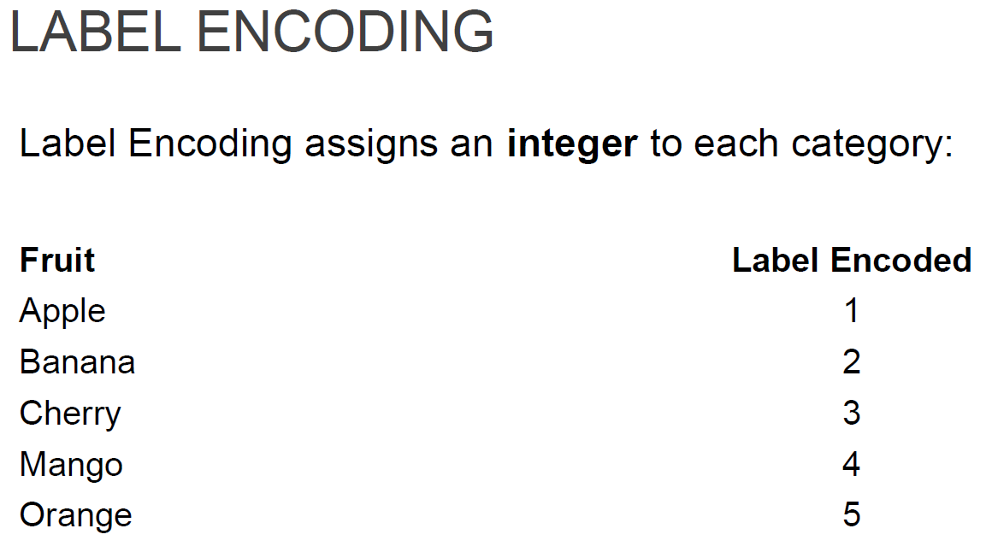

Slide 16
Disadvantages of Label Encoding
Fruits don't have a ranking there's no 'first place' fruit.
But label encoding tricks your model into thinking there's a race going on:
"It assumes Mango > Banana > Apple"
"It thinks Cherry is closer to Mango than to Apple"
"It makes decisions based on fake numbers!"

Slide 17
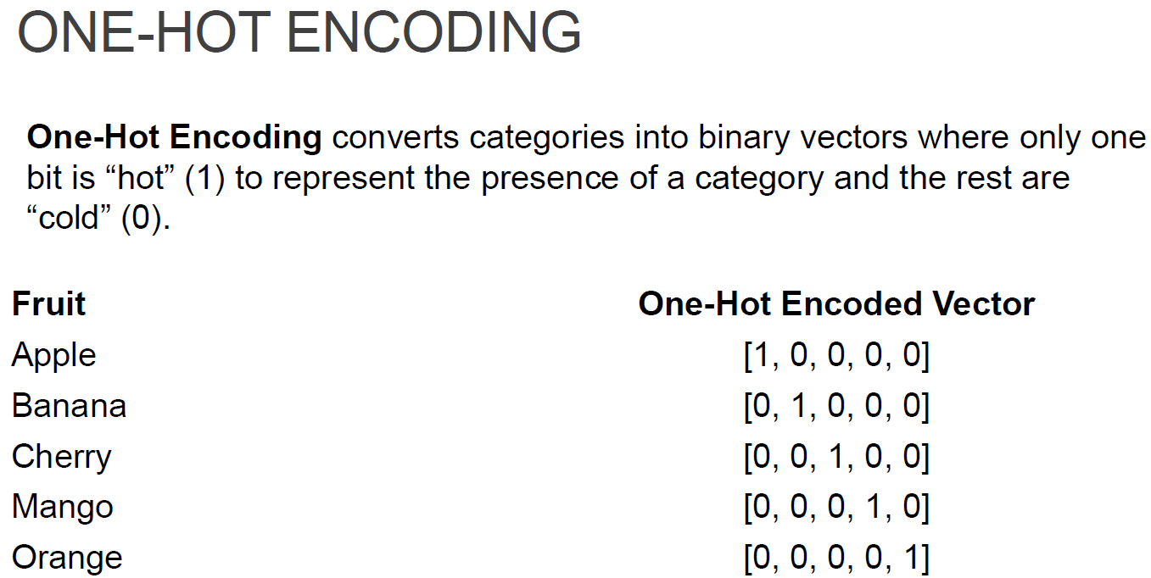

Slide 18
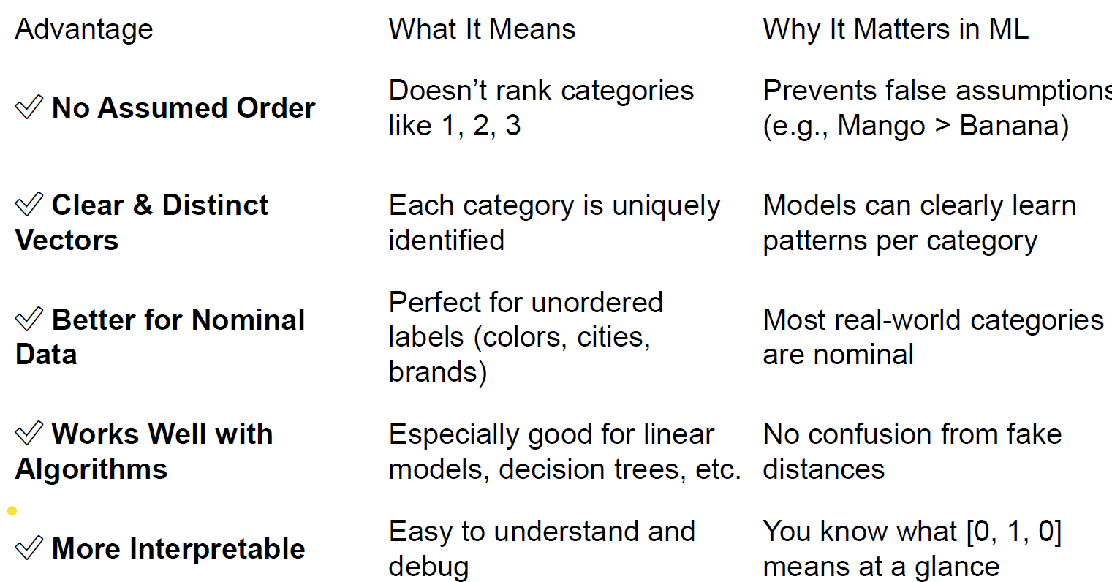

Slide 19
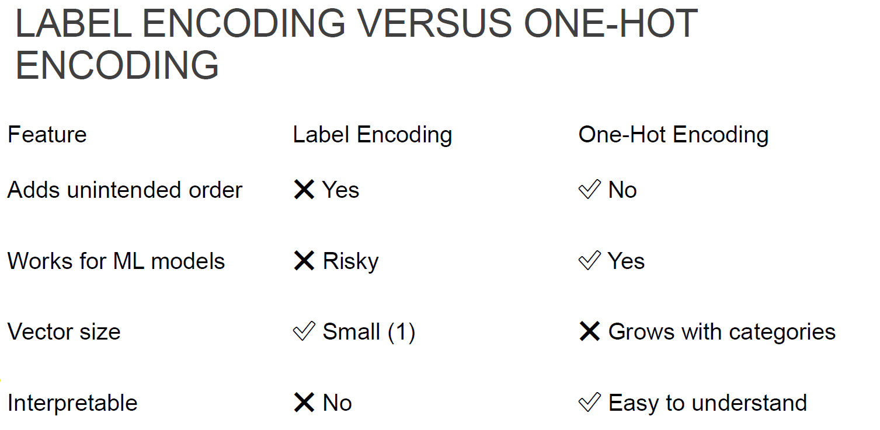

Slide 20
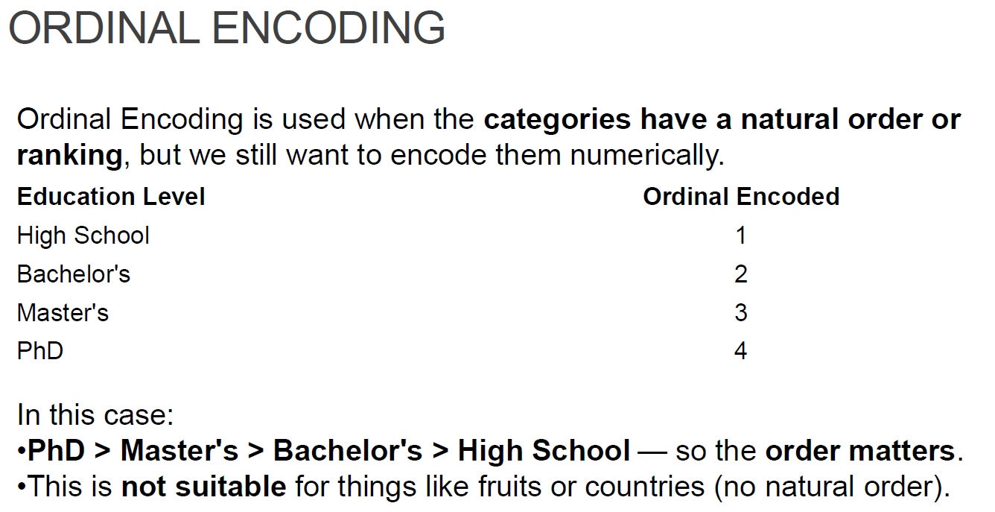

Slide 21
Types of Data
Text data is a sequence of characters or words. It is usually unstructured and requires preprocessing to convert into numerical form.
Example: A product review that says "This phone is excellent!"
Machine learning models work with numbers — not raw text. Text data is unstructured: words must be converted into numerical features.

Slide 25
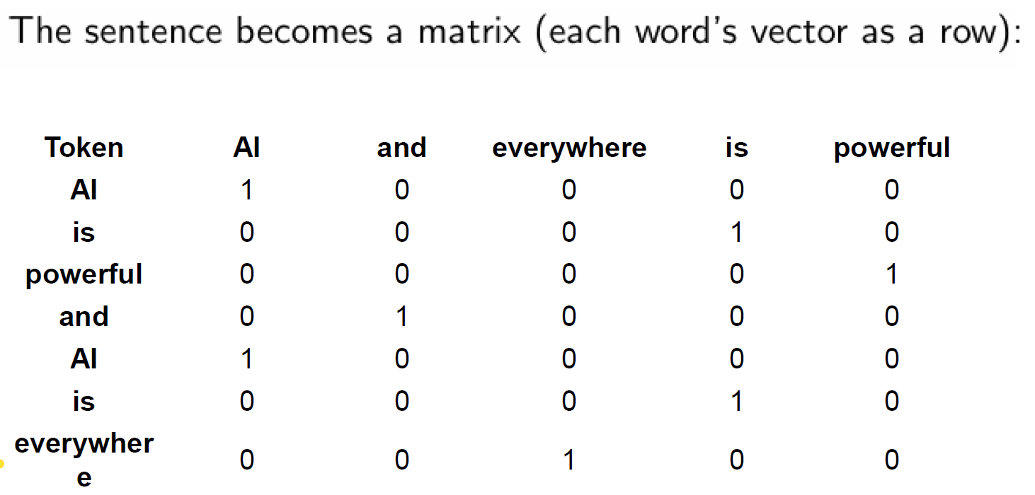

Slide 26
Linear Algebra
Data in computer systems is structured numerically.
Linear algebra offers a compact and efficient framework to represent and analyze data
Key representations:
Vectors: One-dimensional arrays representing data points or features.
Matrices: Two-dimensional arrays representing datasets.

Slide 27
Role of Linear Algebra in Data Representation
Data Representation
Data Transformation
Dimensionality Reduction
Machine Learning Algorithms
Correlation Analysis
Distance and Similarity Calculations

Slide 28
1. Data Representation
Datasets are often represented as vectors and matrices, wherein every row corresponds to an observation and every column represents a function. This matrix illustration permits efficient manipulation and data analysis
Datasets are often structured as matrices, where:
Each row = one observation/data point
Each column = one feature/variable/function

Slide 29
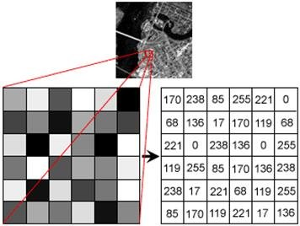
Example:- Representation of an image
In image processing, a matrix is a fundamental way to represent an image using numerical values. For a grayscale image, each pixel corresponds to an intensity value ranging from 0 (black) to 255 (white), and the image is represented as a 2D matrix where each element holds one of these values.
This matrix-based representation allows the application of various linear algebra operations such as transformations, filtering, and compression.

Slide 30
2.Data Transformation
Scaling, rotating, translating data is need in many data sets including image datasets
E.g. in image data: Objects may appear in different positions, sizes, or orientations.
So, we Scale (resize), Rotate (align) or Translate (center)

Slide 31
3. Dimensionality Reduction
Dimensionality reduction is mainly the process of reducing the number of features (variables) in a dataset while preserving as much important information as possible.
Singular Value Decomposition (SVD) and Principal Component Analysis (PCA) methods rely on principles from linear algebra to decrease the complexity of data while retaining critical information.
This helps to:
Reduce computational complexity
Remove noise and redundancy
Visualize high-dimensional data in 2D or 3D

Slide 32
4. Machine Learning Algorithms
Many machine learning algorithms use linear algebra operations such as dot products, matrix multiplication, vector projections, and inversions to learn patterns from data and make predictions.

Slide 33
5. Correlation Analysis
Correlation is a statistical measure that describes the strength and direction of a linear relationship between two variables.
Correlation matrices are calculated using dot products and matrix multiplication.

Slide 34

6. Distance and Similarity Calculations
To measure how similar two vectors are in direction, we use cosine similarity, which is based on the dot product and the norms of vectors in linear algebra.

